Slide 2
Chapter 3:
Maximum-Likelihood and Bayesian Parameter Estimation (part 2)
Bayesian Estimation (BE)
Bayesian Parameter Estimation: Gaussian Case
Bayesian Parameter Estimation: General Estimation
Problems of Dimensionality
Computational Complexity
Component Analysis and Discriminants
Hidden Markov Models

Slide 3
Bayesian Estimation (Bayesian learning to pattern classification problems)
  In MLE θ was supposed fix
  In BE θ is a random variable
  The computation of posterior probabilities P(ω_{i} | x) lies at the heart of Bayesian classification
  Goal: compute P(ω_{i} | x, D)
  Given the sample D, Bayes formula can be written
3

Slide 4
To demonstrate the preceding equation, use:
3

Slide 5
Bayesian Parameter Estimation: Gaussian Case
Goal: Estimate θ using the a-posteriori density P(θ | D)
  The univariate case: P(μ | D)
  μ is the only unknown parameter
  (μ₀ and σ₀ are known!)
4

Slide 6
  Reproducing density
  Identifying (1) and (2) yields:
4

Slide 7
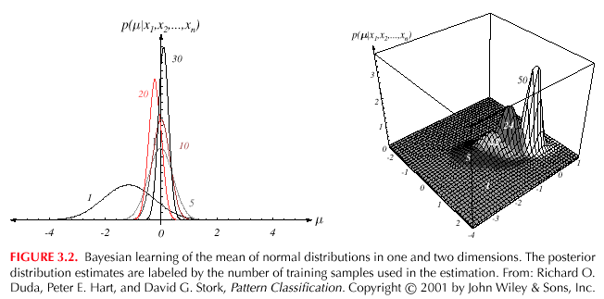
4

Slide 8
  The univariate case P(x | D)
    P(μ | D) computed
    P(x | D) remains to be computed!
    It provides:
    (Desired class-conditional density P(x | D_{j}, ω_{j}))
    Therefore: P(x | D_{j}, ω_{j}) together with P(ω_{j})
    And using Bayes formula, we obtain the
    Bayesian classification rule:
4

Slide 9
Bayesian Parameter Estimation: General Theory
  P(x | D) computation can be applied to any situation in which the unknown density can be parametrized: the basic assumptions are:
    The form of P(x | θ) is assumed known, but the value of θ is not known exactly
    Our knowledge about θ is assumed to be contained in a known prior density P(θ)
    The rest of our knowledge θ is contained in a set D of n random variables x₁, x₂, …, x_{n} that follows P(x)
5

Slide 10
The basic problem is:
“Compute the posterior density P(θ | D)”
then “Derive P(x | D)”
Using Bayes formula, we have:
And by independence assumption:
5

Slide 11
Problems of Dimensionality
  Problems involving 50 or 100 features (binary valued)
    Classification accuracy depends upon the dimensionality and the amount of training data
    Case of two classes multivariate normal with the same covariance
7

Slide 12
    If features are independent then:
    Most useful features are the ones for which the difference between the means is large relative to the standard deviation
    It has frequently been observed in practice that, beyond a certain point, the inclusion of additional features leads to worse rather than better performance: we have the wrong model !
7

Slide 13
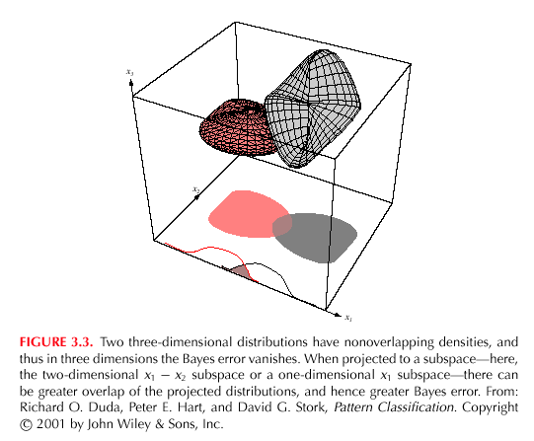
7
7
7

Slide 14
Computational Complexity
  Our design methodology is affected by the computational difficulty
    “big oh” notation
    f(x) = O(h(x)) “big oh of h(x)”
    If:
    (An upper bound on f(x) grows no worse than h(x) for sufficiently large x!)
    f(x) = 2+3x+4x²
    g(x) = x²
    f(x) = O(x²)
7

Slide 15
      “big oh” is not unique!
    f(x) = O(x²); f(x) = O(x³); f(x) = O(x⁴)
    “big theta” notation
    f(x) = θ(h(x))
    If:
    f(x) = θ(x²) but f(x) ≠ θ(x³)
7

Slide 16
  Complexity of the ML Estimation
    Gaussian priors in d dimensions classifier with n training samples for each of c classes
    For each category, we have to compute the discriminant function
    Total = O(d²..n)
    Total for c classes = O(cd².n) ≅ O(d².n)
    Cost increase when d and n are large!
7

Slide 17
Component Analysis and Discriminants
  Combine features in order to reduce the dimension of the feature space
  Linear combinations are simple to compute and tractable
  Project high dimensional data onto a lower dimensional space
  Two classical approaches for finding “optimal” linear transformation
    PCA (Principal Component Analysis) “Projection that best represents the data in a least- square sense”
    MDA (Multiple Discriminant Analysis) “Projection that best separates the data in a least-squares sense”
8

Slide 18
Hidden Markov Models:
  Markov Chains
  Goal: make a sequence of decisions
    Processes that unfold in time, states at time t are influenced by a state at time t-1
    Applications: speech recognition, gesture recognition, parts of speech tagging and DNA sequencing,
    Any temporal process without memory
    ω^{T} = {ω(1), ω(2), ω(3), …, ω(T)} sequence of states
    We might have ω⁶ = {ω1, ω4, ω2, ω2, ω1, ω4}
    The system can revisit a state at different steps and not every state need to be visited
10

Slide 19
  First-order Markov models
    Our productions of any sequence is described by the transition probabilities
    P(ω_{j}(t + 1) | ω_{i} (t)) = a_{ij}
10

Slide 20
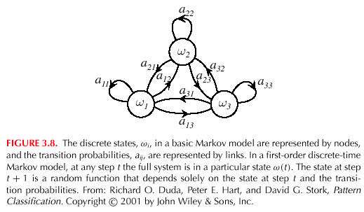
10

Slide 21
  θ = (a_{ij}, ω^{T})
  P(ω^{T} | θ) = a₁₄ . a₄₂ . a₂₂ . a₂₁ . a₁₄ . P(ω(1) = ω_{i})
  Example: speech recognition
  “production of spoken words”
  Production of the word: “pattern” represented by phonemes
  /p/ /a/ /tt/ /er/ /n/ // ( // = silent state)
  Transitions from /p/ to /a/, /a/ to /tt/, /tt/ to er/, /er/ to /n/ and /n/ to a silent state
10

